Slide 1
Baltimore Next Steps Survey Data

Slide 2
Background
Since 2011, Artists U/Baltimore has offered workshops and conversations on building a sustainable artistic life. We wanted to look beyond our specific programs to the broader artist community. In this project Next Steps we worked to build a grounded inclusive strategic conversation about professional development.
We brought together artists and organizations focused on professional development for a series of four roundtable conversations.
We surveyed 400 Baltimore artists about artistic practice survival strategies challenges both professional and personal and definitions of success.
We hosted a focus group with fourteen artists to dig more deeply into issues raised by our survey data.
We partnered with Dr. Brea Heidelberg arts researcher and professor at Drexel University to analyze the survey and focus group responses.

Slide 3
Caveats
This is not an artist census or a comprehensive portrait of Baltimore artists. The goal of our survey and focus group was to uncover actionable findings, things can use to build new programs partnerships and networks. Our guiding question was: How will this help us make better decisions?
This was not a random sampling. For this survey we used the “snowball” method to get responses: we invited artists in our networks to complete the survey and to share it with their networks. Most respondents have a direct connection to or are one or two degrees removed from a professional development program like Artists U.
It’s important to be cautious when reducing artists’ lives and experiences to a collection of statistics. Numbers can be useful in uncovering trends and tendencies but they can also mask complexities within a group or even within one artist. We in Artists U continue to ground our understandings in the lived experiences and testimony of the artists we work with. We believe data is useful only in the context of embodied connections and community.

Slide 4
I am…. Check all that apply.

Slide 5
Which broad category is currently the main focus of your work? Please choose one.

Slide 6
What artistic discipline(s) do you currently work in? Check all that apply.

Slide 7
How do you define success in terms of AUDIENCE? What do you want your art to do? What impact matters to you? Rate from 1 (Unimportant to Me) to 5 (Extremely Important to Me).

Slide 8
How do you define success in terms of COMMUNITY and TRADITION? What impact matters to you?

Slide 9
How do you define success in terms of DISCUSSION? What impact matters to you?

Slide 10
How do you define success in terms of PRACTICE? What impact matters to you?

Slide 11
Are you succeeding on your own terms? Rate from 1 (I am not having any impact or success that matters to me) to 10 (I consistently achieve impact or success that matters to me).
AVERAGE: 6.22

Slide 12
What else would you like to do? Check your preference for each item.

Slide 13
Do you find the broader community of Baltimore artists supportive and welcoming? Rate from 1 (Entirely Unsupportive) to 10 (Entirely Supportive).
Average: 6.47

Slide 14
Overall, do you find Baltimore arts organizations supportive and welcoming? Rate from 1 (Entirely Unsupportive) to 10 (Entirely Supportive).
Average: 6.18

Slide 15
Do you feel optimistic about your future as an artist in the Baltimore region? Rate from 1 (Completely Pessimistic) to 10 (Completely Optimistic).
Average: 6.41

Slide 16
How often do you share your work beyond Baltimore?

Slide 17
What skills do you want to learn or strengthen? Rate each of the following from 1 (No Interest) to 5 (Urgent Interest).

Slide 18
Who do you want to add to your network, your circle of support? Check all that apply.

Slide 19
“I could have more impact and deepen my work if I had _________.” A huge pile of money? Yes, we agree. What else? Choose 3 items that would have the biggest impact.

Slide 20
What is the highest level of education you have received?

Slide 21
Are you living with a physical or cognitive challenge / disability?
If you answered Yes, on a scale of 1 to 10, how would you rate the overall accessibility of the Baltimore art scene?
Rate from 1 (Not at all accessible) to 10 ( Very accessible).
AVERAGE RATING: 4.63

Slide 22
How many years have you called the Baltimore region home?

Slide 23
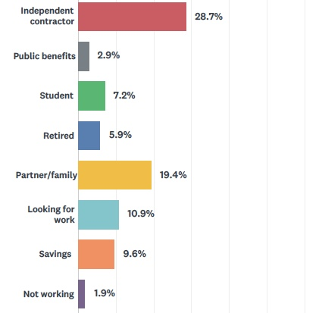
How do you make a living? Please include both artistic work and work not related to your art. Check all that

Slide 24
Not including teaching art, about how much of your annual individual income do you make from your artistic practice (including selling work, commissions, grants and fellowships, touring, royalties)?

Slide 25
About how much of your annual individual income do you make from teaching art?

Slide 26
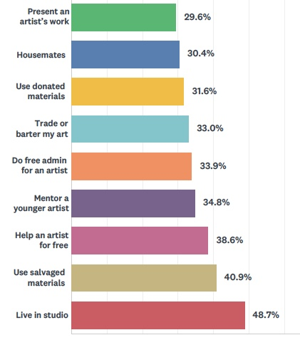
Many artists seek out ways to live and work affordably, using community, barter, and trade. Which of the following have you done in the past year? Check all that apply.

Slide 27
In the past year, about how many hours per week did you spend making art? AVERAGE: 16.6 In the past year, about how many hours per week did you spend working on the business work of your art life (promoting your work, writing grants, getting gigs, etc)? AVERAGE: 8.9 In the past year, about how many hours per week did you spend on Income-earning work NOT related to your art? AVERAGE: 28.2 TOTAL AVERAGE WEEKLY WORK HOURS: 53.7

Slide 28
In the past year, about how many hours per week did you spend making art? AVERAGE: 16.6 Given how your life is currently, how many hours per week would you like to spend making art? AVERAGE: 28.8 DIFFERENCE BETWEEN CURRENT AND DESIRED ART TIME: 12.2 hrs/week

Slide 29
How balanced do you feel in these seven areas? Please rate from 1 (Totally Out of Balance) to 10 (Perfectly Balanced).

Slide 30
How in control do you feel of the business work of your art life (promoting your work, writing grants, getting gigs, etc)? Rate from 1 (Completely Out of Control) to 10, (Completely in Control).
Average: 5.19

Slide 31
Overall, how balanced do you feel your life is in terms of work, personal life, art, and time off? Please slide to rate from 1 (Completely out of Balance) to 10 (Completely Balanced).
AVERAGE: 5.32

Slide 32
In the last year, where did you get funds and other resources to support your artistic projects? Check all that apply.

Slide 33
Have you been funded by a foundation or public agency from outside of the Baltimore region?

Slide 34
Do you find that grant funding is available fairly and equitably to everyone in the Baltimore region?

Slide 35
How did you, or do you, learn to make art? Check all that apply.

Slide 36
Have you taken part in any of these Baltimore professional development trainings? Check all that apply.

Slide 37
How have you learned about making a life as an artist (earning money, putting your art out in the world, finding opportunities, etc.)? Check all that apply.

Slide 38
If you had training as an artist, did you get any professional development, that is, education about making a life as an artist? Rate from 1 (None) to 10 ( A Lot).
AVERAGE: 3.73

Slide 39
Overall, how in control of your finances do you feel? Rate from 1 (Entirely Out of Control) to 10 (Entirely in Control).
AVERAGE 6.22

Slide 40
What is your zip code?
341 artists shared their zip code. 294 of those were in Baltimore City. This chart maps the number of responses from Baltimore City zip codes.

